Slide 1
Neuro-bubbles 4June 2024 session autopsy
June 12th, 2024

Slide 2
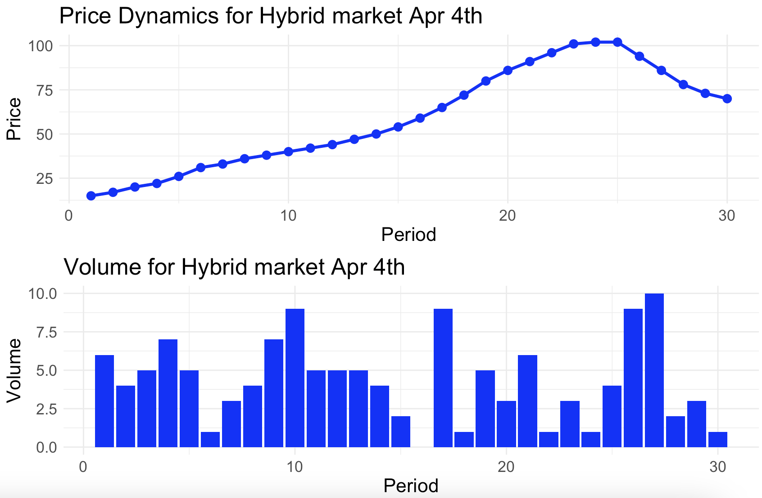
Price and volume dynamics

Slide 3
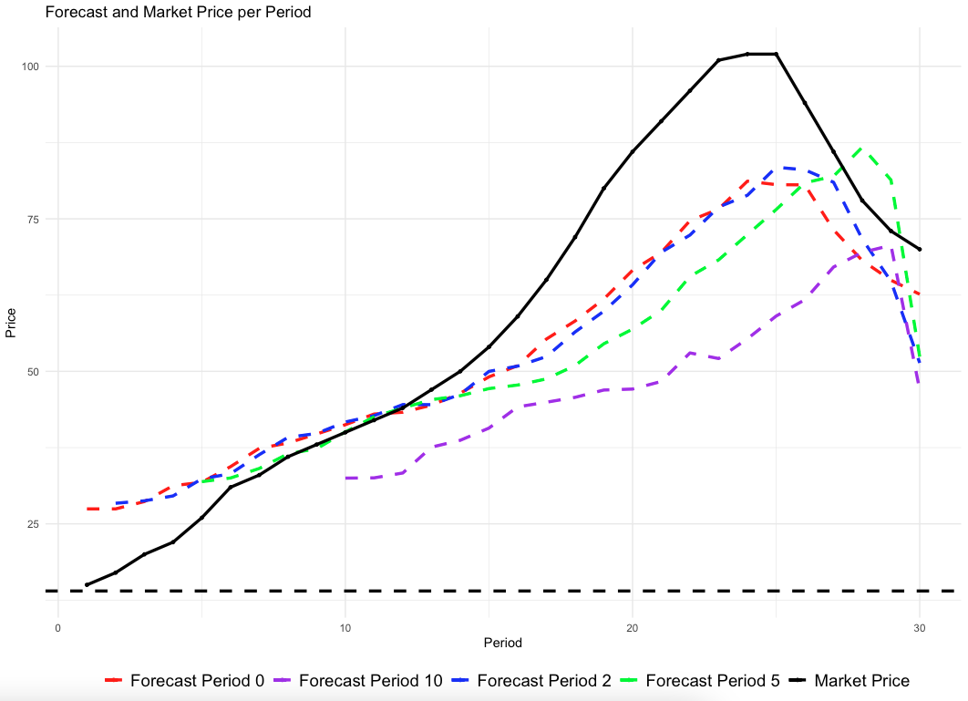
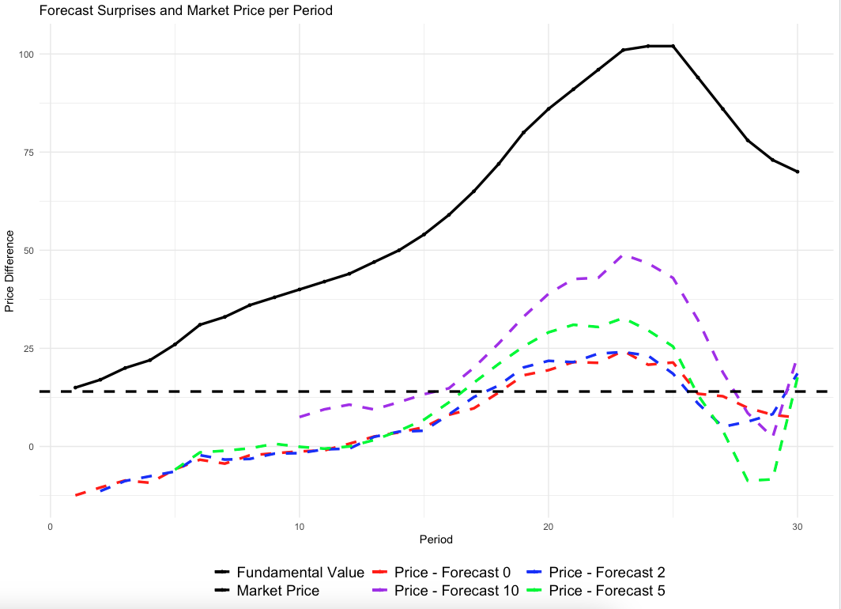
Results – forecast page and forecast surprise
Market price and forecast price
Market price and forecasts differences (P – Forecast)

Slide 4
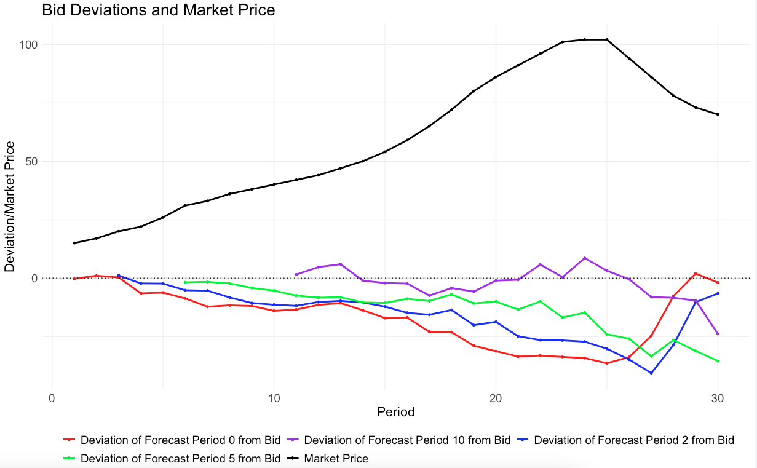
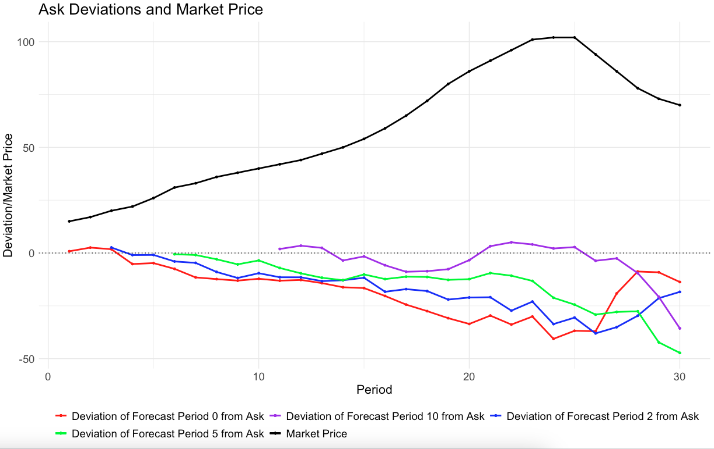
Results – forecast page (rationality check)
Avg. Forecast Period – Avg. Bid
Avg. Ask - Avg. Forecast Period

Slide 5
Results – risk taking parameter R averaged across participants

Slide 6
Results – risk taking parameter Mu averaged across participants

Slide 7
Market price and Avg EDA

Slide 8
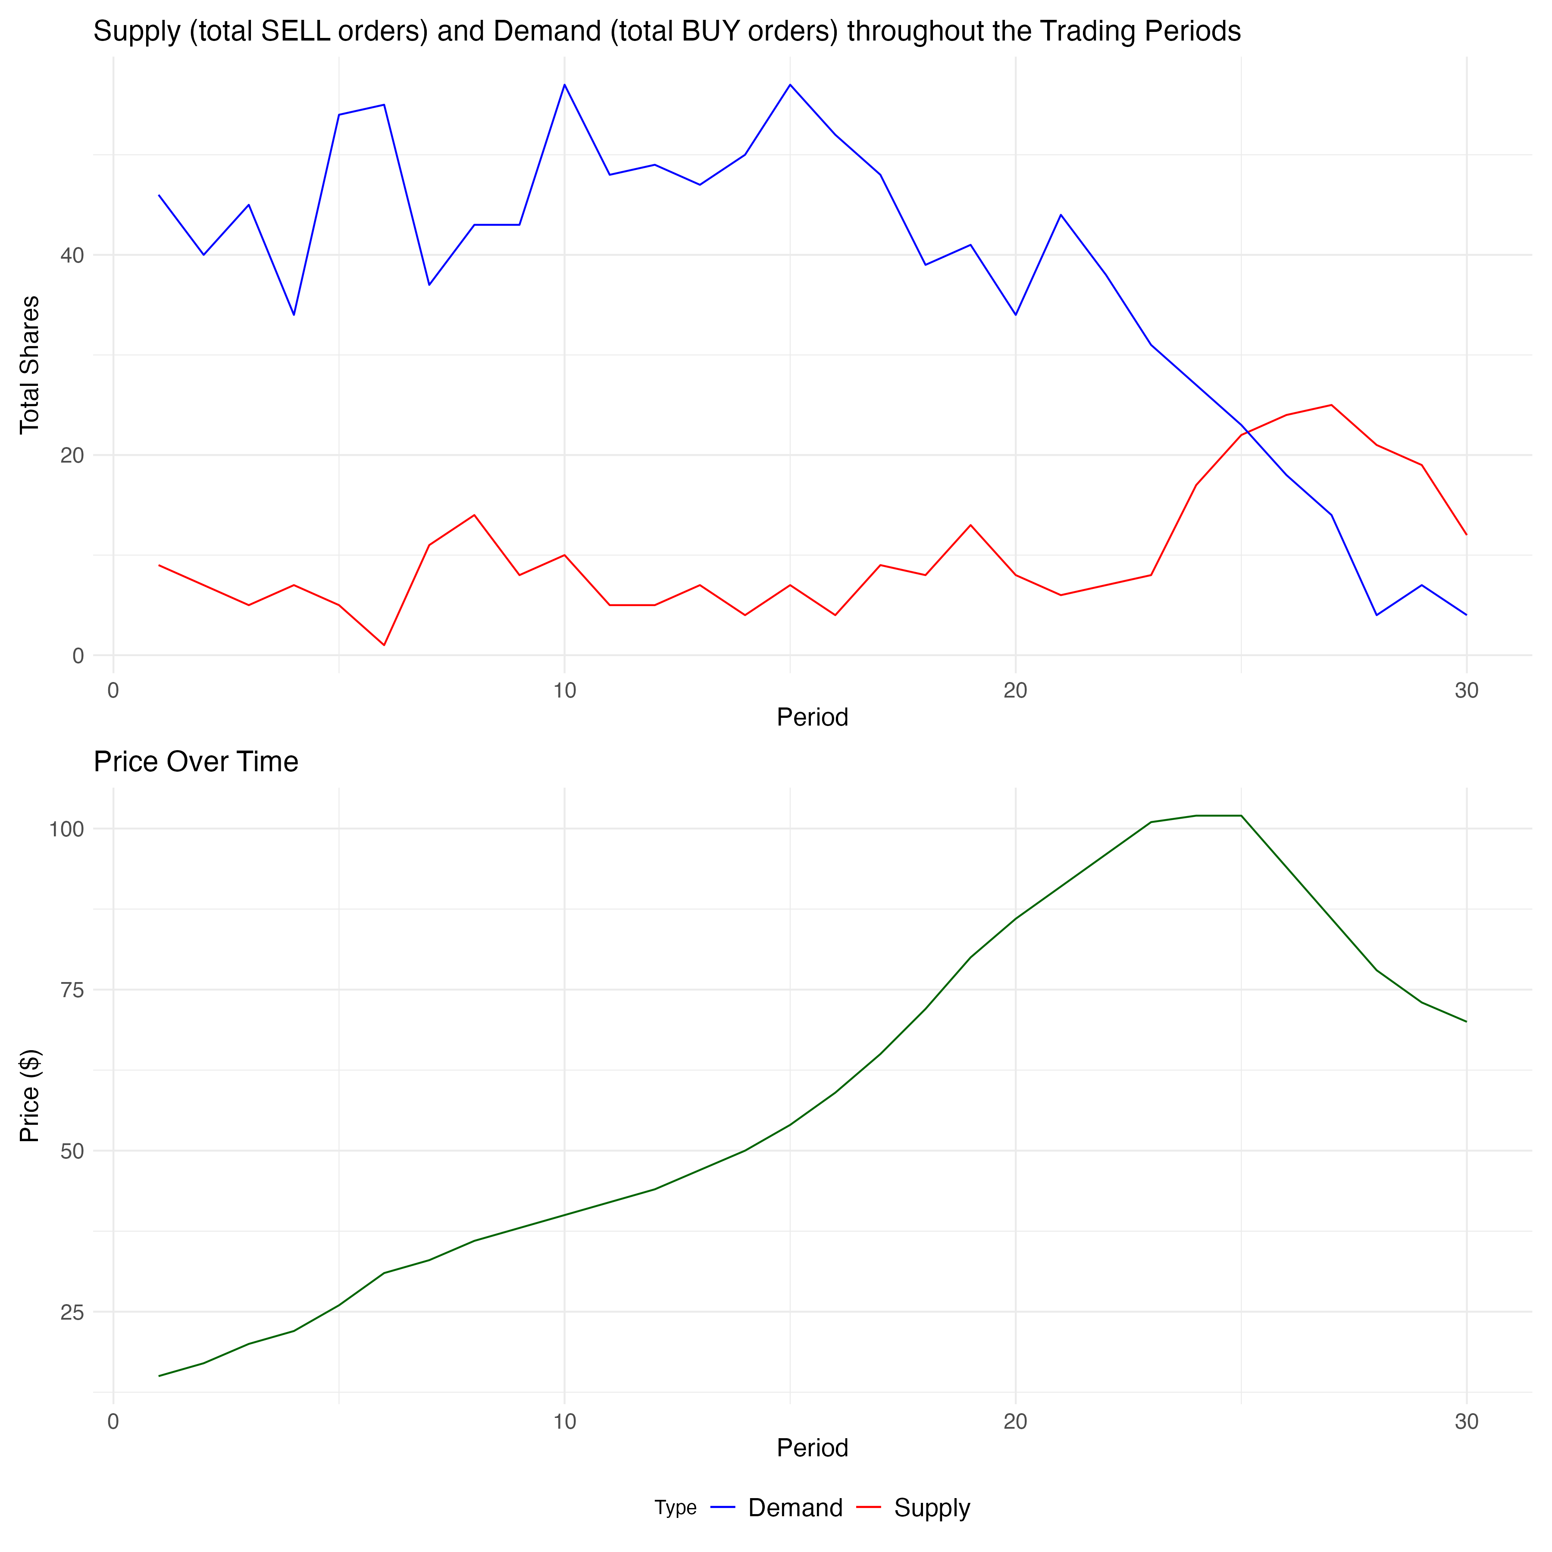
Supply and demand dynamics April 4th

Slide 9
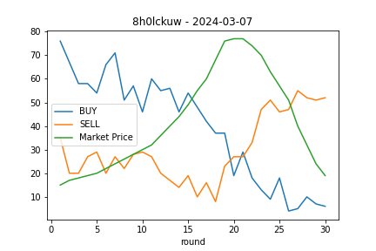
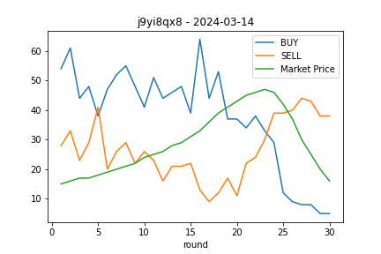
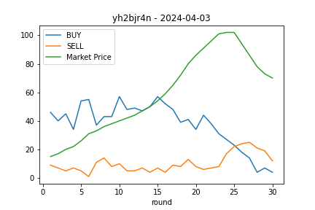
Supply and demand dynamics
March 7th
March 14th
April 4th

Slide 10
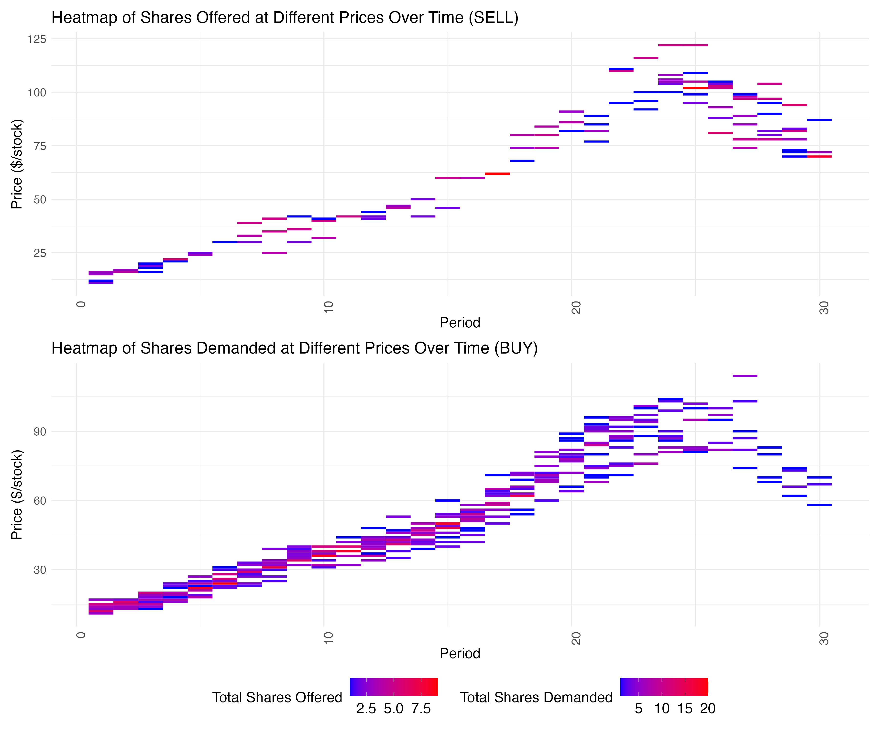
Hybrid 4 April 2024

Slide 11
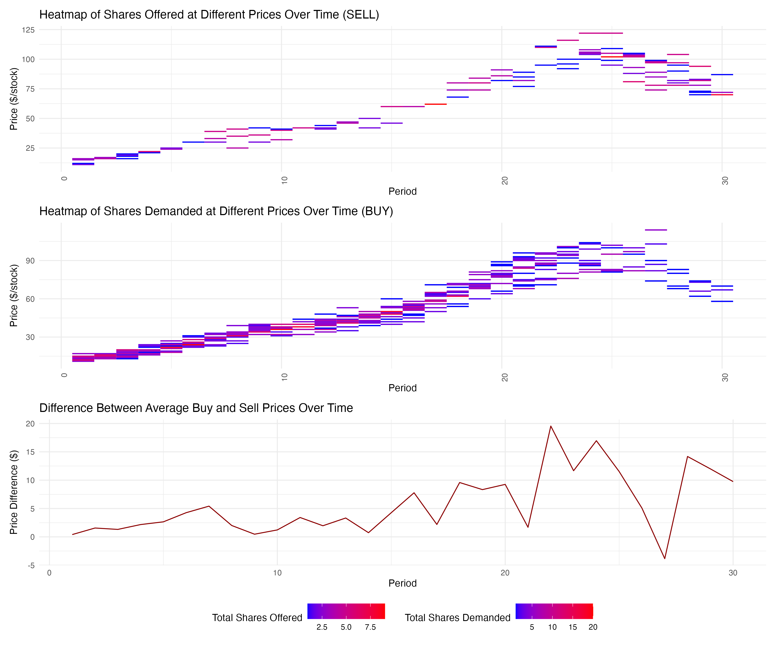
Hybrid 4 April 2024

Slide 12
Summary
Information Asymmetry: Not all participants may have perceived the fundamental value in the same way, or some might have had different information about future prospects, leading to variations in trading behavior.
Supply and Demand Dynamics:
Supply-Demand Divergence (Periods 20-22): As demand begins to fall around period 20-22, supply does not increase correspondingly.
Peak at Period 25: The peak of demand at period 25, while supply continues to be lower and not increase to the same degree as demand was decreasing.
Lack of Sellers at Lower Prices: If many traders are holding stocks hoping for a rebound or are unwilling to sell at lower prices, the supply at the lower price levels could be insufficient to meet any latent demand.
Inelastic Selling: Participants might not have adjusted their selling prices quickly enough to match the declining trend.
Liquidity Constraints: Limited liquidity or the absence of enough market participants.
Proposed solutions:
add another question on fundamental value in the quiz -> that would make a total of 6 questions
underline this information in the video instructions again -> Mihai to do this in Synthesia
emphasize this in the break in between the training and actual trading sessions
make sure we have at least 20 people trading in the market
market maker at the end to “induce” the crash and provide liquidity at around periods 20-25 based on
pre-determined rules? Ross to test

